Slide 1
Project K
Crowd Source Learning, Collaborative Coding Platform, And Citizen Scientist Service (Solar Graph).

Slide 2
Introduction
Overview of Project K
Project K aims to bring together technology, community, and innovation to advance solar energy tracking.
Focus areas: Crowdsource Learning, Collaborative Coding, and Citizen Scientist Services.
Solar Graph: A tool to monitor and visualize solar energy data.

Slide 3
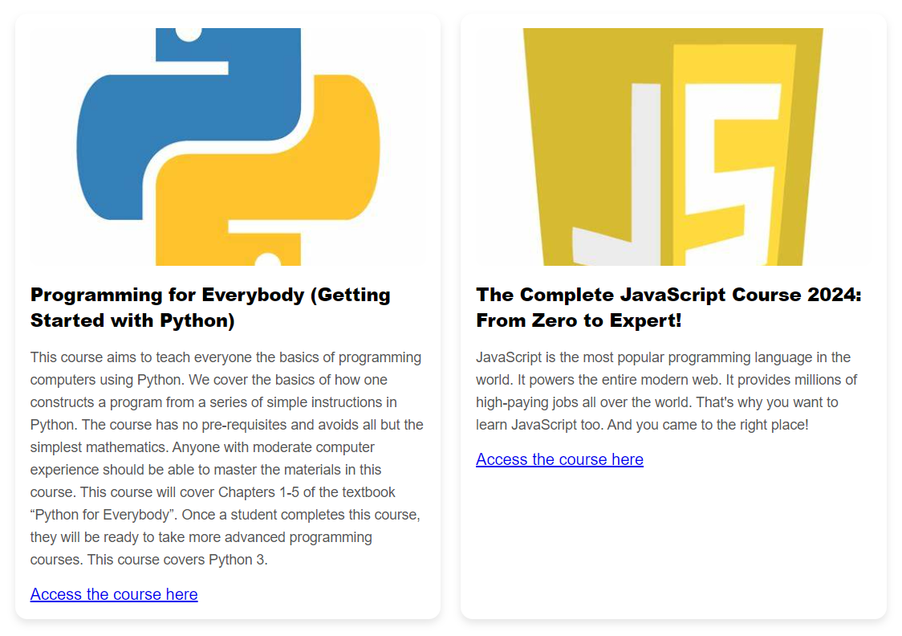
Crowdsource Learning in Project K
Harnessing the power of the community to share knowledge and learning resources.
Concept: Learners and professionals from diverse backgrounds contribute to the knowledge base.
Benefits:
Accelerated learning through shared experiences.
Open access to learning materials and insights.

Slide 4
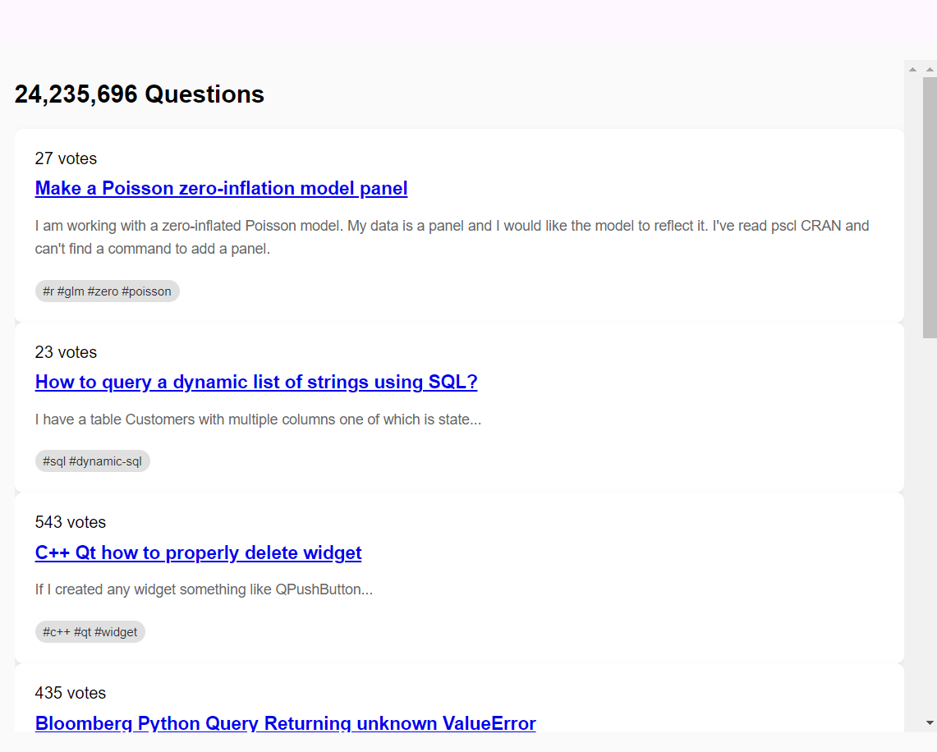
Collaborative Coding Platform
Open-source coding efforts where developers work together on a shared platform.
Benefits: Faster innovation through collective intelligence.
Peer-reviewed code ensures robustness and quality.

Slide 5
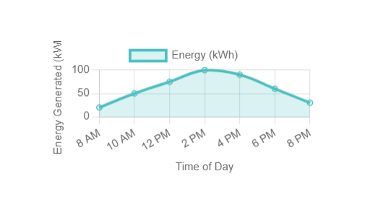
Empowering Citizen Scientists with Solar Data
Citizen Scientist: Volunteers who contribute solar energy data and use the Solar Graph tool to track energy generation trends.
Role:
Real-time data collection from homes, businesses, and public institutions.
Contribution:
It gives the trends about the solar energy generation from the solar panels with the help of real time data collections.

Slide 6
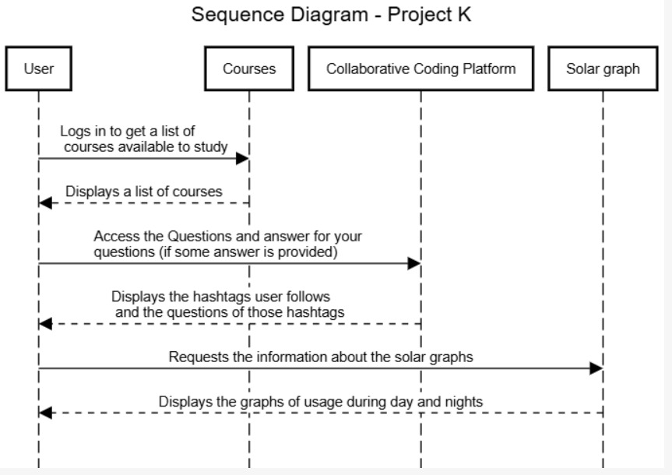
Sequence Diagram

Slide 7
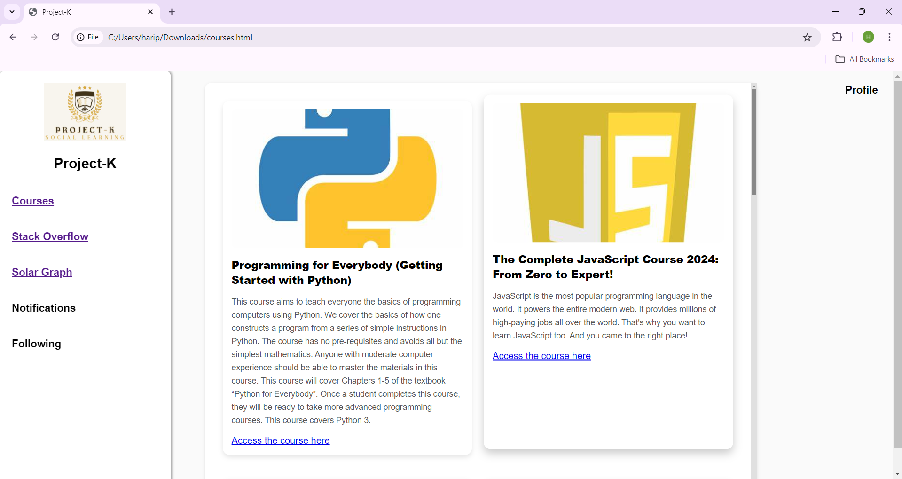
Website Illustration

Slide 8
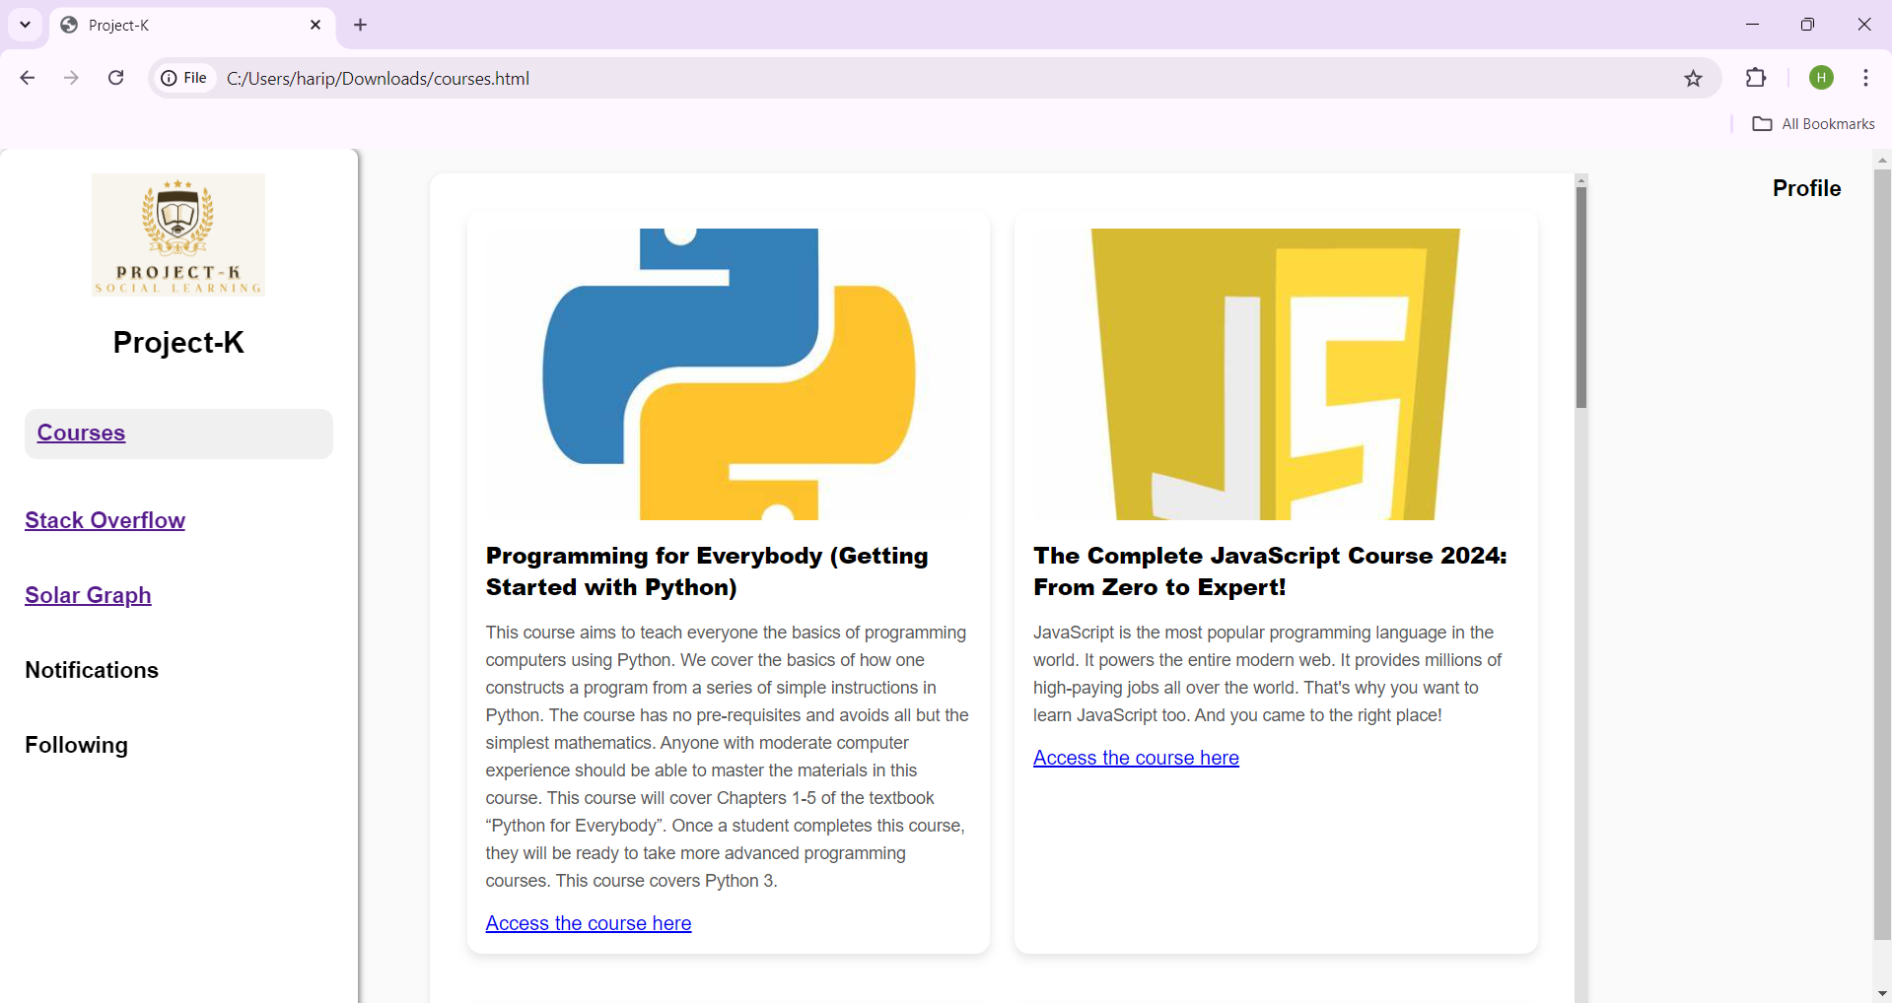
Cont…

Slide 9
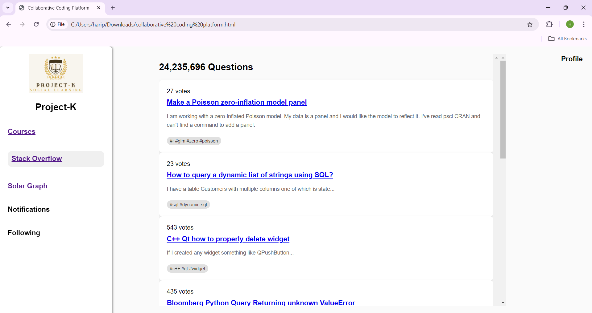
Cont…

Slide 10
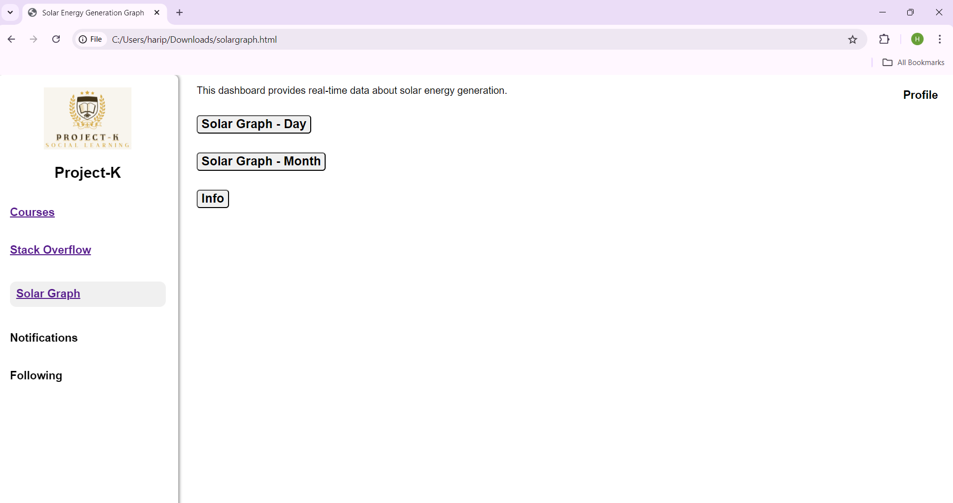
Cont…

Slide 11
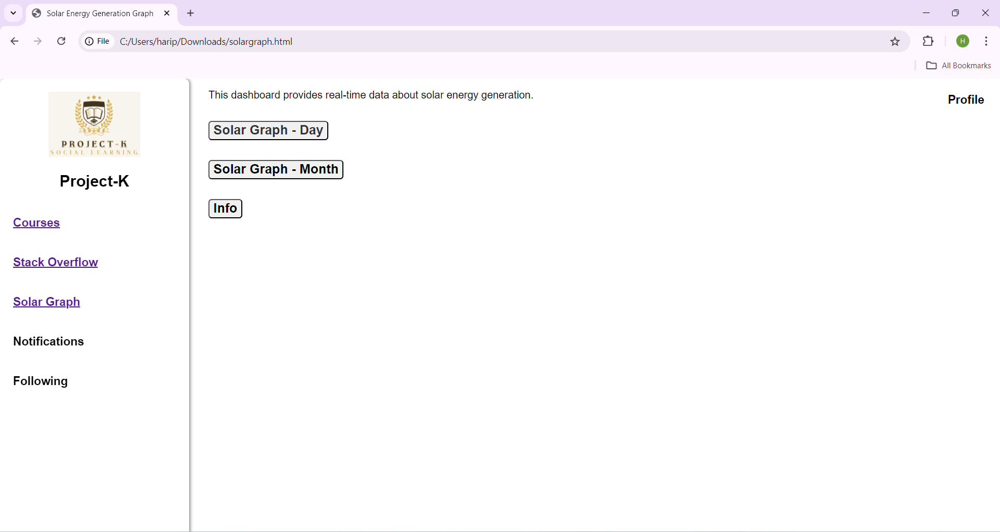

Slide 12
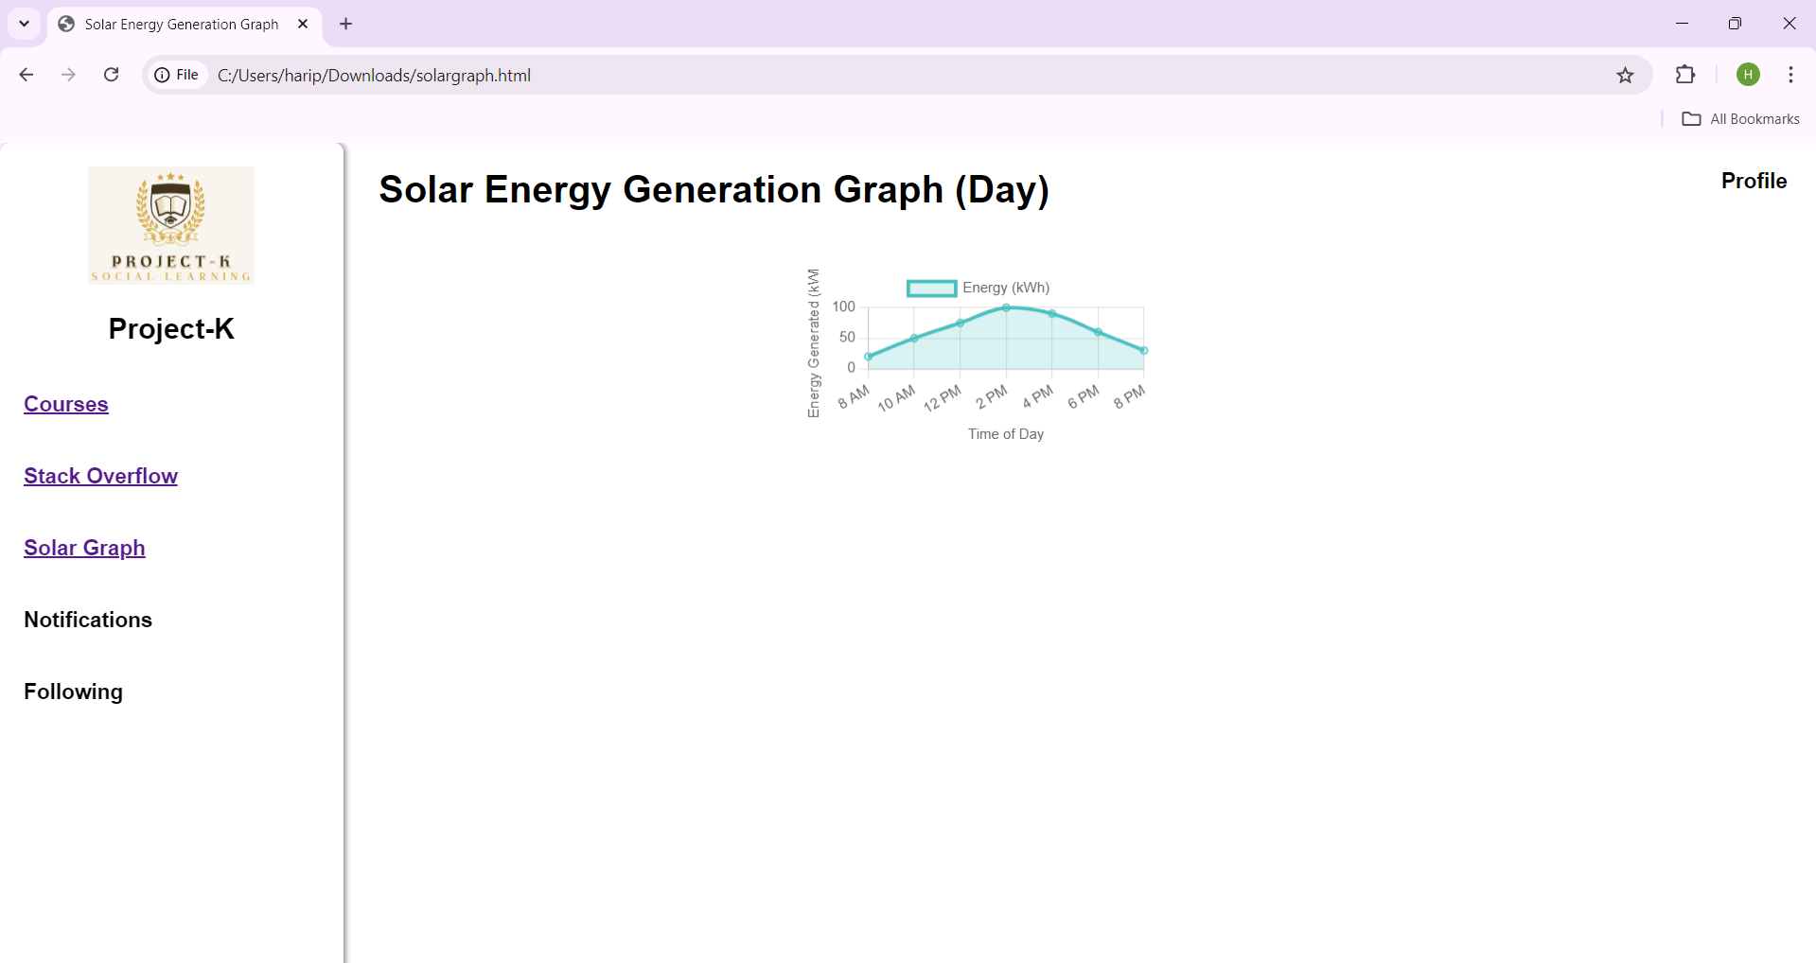

Slide 13
Advantages of Project K
Advantages of a Crowdsourced, Collaborative Approach
Diverse Contributions:
Involves professionals, learners, and citizens.
Scalability:
Open-source contributions allow for rapid expansion.
Sustainability:
Increased data collection supports renewable energy initiatives.
Community Impact:
Empowers individuals to contribute to global energy solutions.

Slide 14
Conclusion
Recap: Project K harnesses the power of community-driven learning, collaborative coding, and citizen science to advance solar energy monitoring.
Call to Action: Join the effort—whether as a developer, learner, or citizen scientist—to push solar energy tracking forward.
Visualization: Data is visualized in a line graph format showing energy generation over time.
Technology Stack: Built using web technologies such as HTML5, Chart.js, and backend frameworks.

Slide 15
Thank You!

